Slide 1
SECURE DATA HANDLING IN IMAGE USING STENOGRAPHY
CAPSTONE PROJECT
Presented By:
Student Name : Samruddhi Baburao Jadhav
College Name : Rajarambapu Institute Of Technology, Sakharale, Sangli, Maharashtra, India
Department: B.Tech AIML Engineering

Slide 2
OUTLINE
Problem Statement
Technology used
Wow factor
End users
Result
Conclusion
Git-hub Link
Future scope

Slide 3
PROBLEM STATEMENT
In today's digital world, securing sensitive data is a major challenge. Traditional encryption methods, while effective, can attract unwanted attention, making them vulnerable to attacks. Steganography provides a discreet way to embed data within images, ensuring confidentiality without arousing suspicion. Our project integrates password-protected steganography with a user-friendly interface, making secure communication accessible and efficient.
Key Points:
Encryption methods are prone to detection and attacks.
Steganography enables hidden data transmission within images.
Ensures secure message embedding and extraction.
User-friendly design for seamless usability.

Slide 4
TECHNOLOGY USED
To ensure efficiency and security, our project leverages advanced tools and frameworks.
Technologies Implemented:
Python: Core programming language for implementation.
OpenCV: Handles image processing operations.
NumPy: Optimizes data handling and manipulation.
Streamlit: Provides an intuitive web-based interface.
SHA-256 Hashing: Secures passwords for data protection.

Slide 5
WOW FACTORS
What makes our project unique is its combination of security, usability, and efficiency.
Key Features:
Encrypted Steganography: Data is not only hidden but also protected with a password.
Invisible Data Embedding: No visible distortions in the modified image.
Interactive UI: Streamlit-based interface for easy encryption/decryption.
Secure Access Control: Only authorized users can retrieve hidden data.
Minimal Image Alteration: Maintains image quality while embedding data.

Slide 6
END USERS
This system is beneficial for various domains where secure communication is essential.
Who Can Use It?
Cybersecurity Professionals: For confidential data transfer.
Journalists & Activists: Securely share sensitive information.
Government Agencies: Protect classified communications.
Privacy-Conscious Users: Personal data protection.

Slide 7
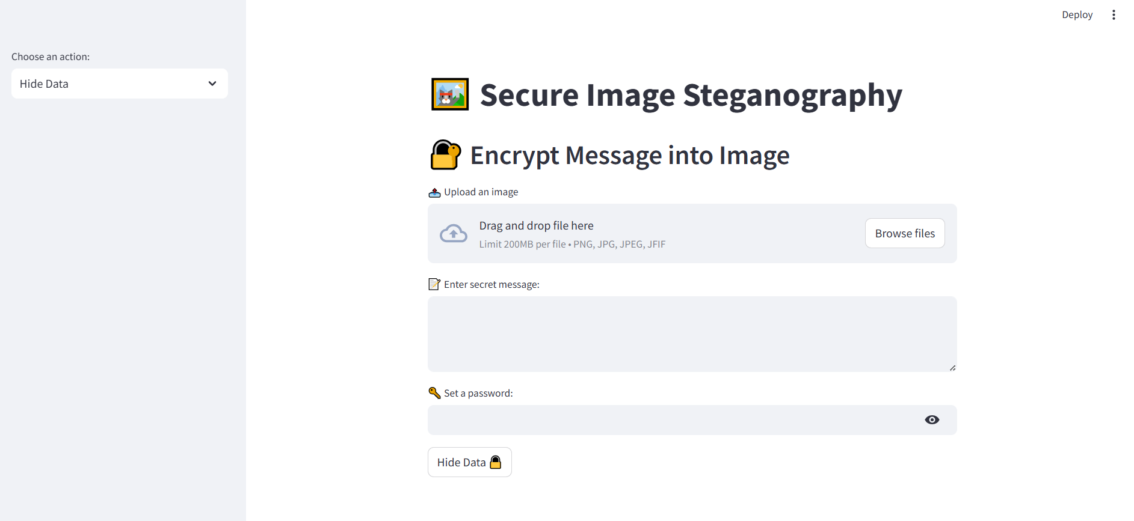
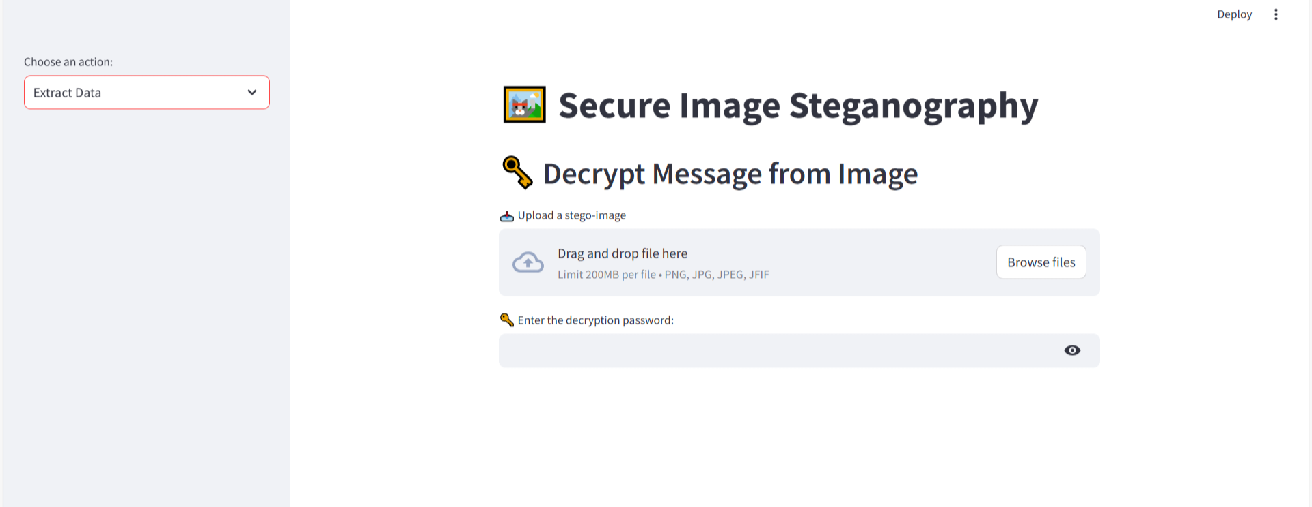
RESULTS: INTERFACE

Slide 8
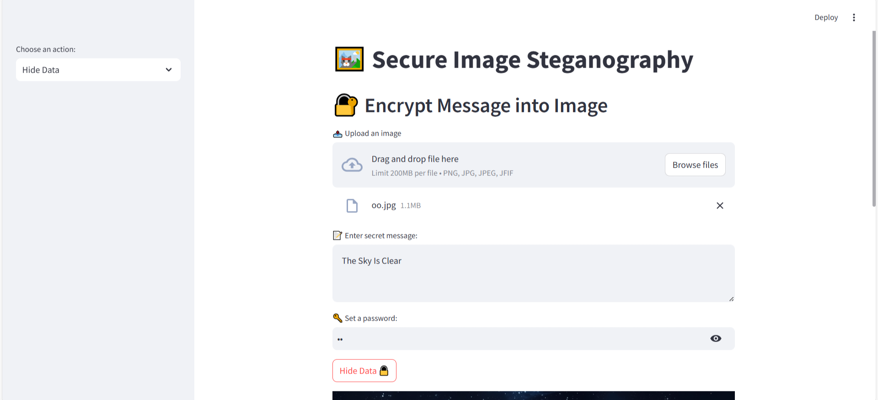
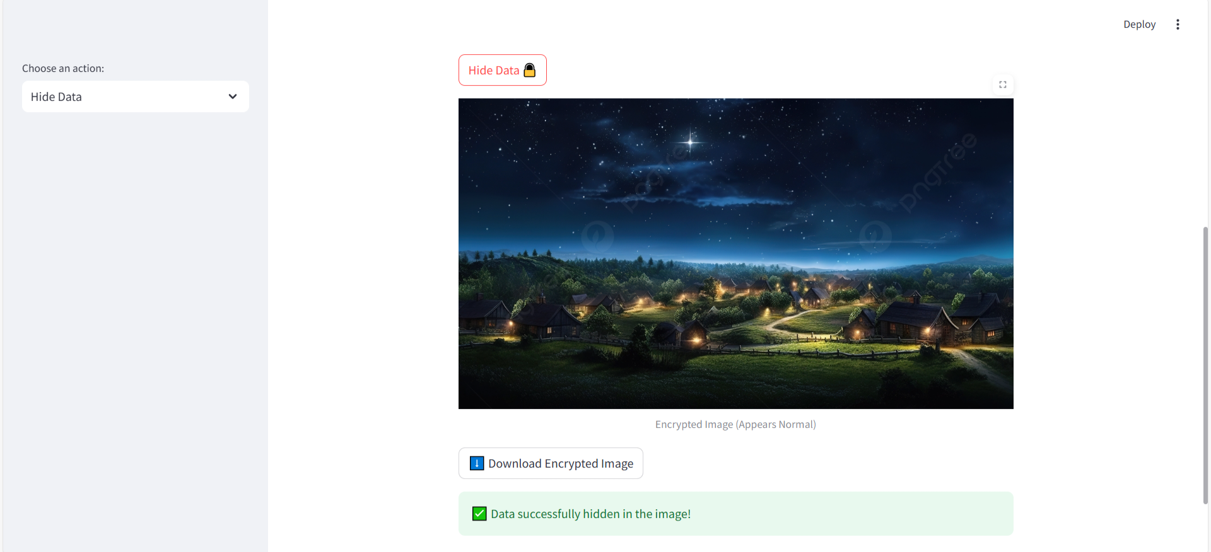
Encryption:

Slide 9
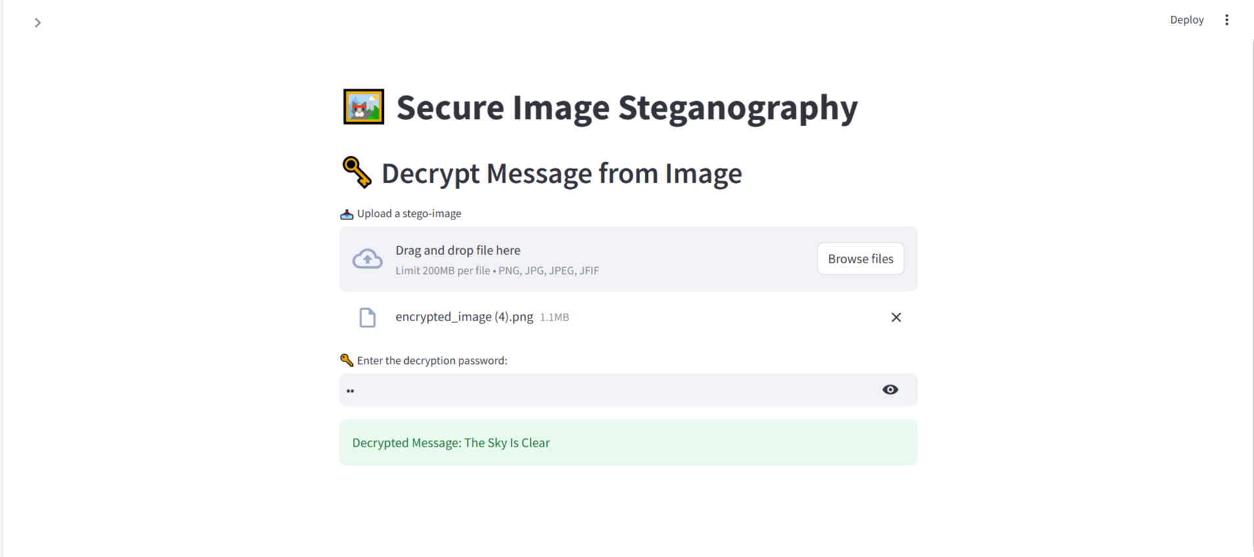
Decryption:

Slide 10
CONCLUSION
In conclusion, this project effectively integrates secure data hiding within images using steganography, providing a robust and discreet communication channel. The addition of password-protected encryption strengthens security, ensuring that only authorized individuals can retrieve the hidden information. Designed for efficiency and ease of use, the system offers a seamless and lightweight solution for safeguarding sensitive data. By complementing traditional encryption techniques with stealthy message concealment, this approach enhances privacy, making it a valuable tool for secure digital communication.

Slide 11
GITHUB LINK
The project is open-source and available on GitHub.
GitHub Repository:
https://github.com/Samruddhi-jadh/Secure_Image_Stegnography
The Repository Contains:
📂 Source Code: Contains scripts for encryption and decryption
Implements secure data hiding techniques.
📄 ReadMe File
Setup Instructions: Step-by-step guide to running the project.
Project Methodology: Overview of encryption, decryption, and steganography approach.
📎 Additional Files: Essential libraries, dependencies, and configurations and resources required for execution.

Slide 12
FUTURE SCOPE(OPTIONAL)
The project has the potential for further enhancements to improve security and usability.
Key Advancements:
Deep Learning Integration: AI-driven steganography for enhanced security.
Multi-Media Support: Extending to audio and video steganography.
Real-Time Encryption: Instant data embedding and extraction.
Mobile Application: Bringing secure communication to smartphones.

Slide 13
THANK YOU

